Slide 1
Customer Churn Analysis Project
Name: Anshuman Sharma
Date:12/08/2025

Slide 2
Business Context
The dataset originates from a travel & tours agency, capturing detailed customer behavior for 954 clients.
The principal aim is to predict and reduce customer attrition (churn), which is currently threatening long-term growth and profitability.
Data-driven insight will:
Empower targeted retention initiatives
Enable proactive service optimization
Help improve the agency’s status as a preferred provider

Slide 3
Problem Statement
The travel and tours agency is experiencing customer attrition, which threatens its long-term sustainability and profitability. To mitigate this issue, the agency aims to predict which customers are at a higher risk of discontinuing their services. By accurately identifying potential churners, the agency can implement targeted retention strategies to improve customer loyalty and reduce churn rates.
Goal : Uncover drivers of churn, create actionable risk segments, and recommend targeted interventions to maximize customer loyalty and revenue.

Slide 4
Dataset Description: Tour & Travels Customer Churn
Context: A dataset from a travel agency aiming to predict customer attrition ("churn") so the business can implement retention strategies.
Level of Data:
Customer-level (Each row == one customer; all columns describe attributes or behaviors of that customer)
Rows & Columns:
Rows: 954 customers
Columns: 7 features (including target variable)

Slide 5
Stake Holders
Senior Leadership / Board
Marketing
CX & Service
Business Intelligence & Data

Slide 6
Technology Stack
Tool | Purpose
Excel | EDA & Data cleaning
SQL | Data cleaning, feature engineering, EDA, cohort analysis
Power BI | Dashboard visualizations, KPI tracking, segment trends
Power BI Services | Sharing and publishing dashboards
PPT | Client communication & reporting
Python | Logistic Regression

Slide 7
Available Data & Data Dictionary
Rows : 954
Columns : 7
Column Name | Type | Example | Description
Age | Integer | 27, 30, 34 | Customer’s age
FrequentFlyer | String | Yes, No | Loyalty program member
AnnualIncomeClass | String | Low, Middle, High | Customer’s income group
ServicesOpted | Integer | 1-6 | How many services booked through agency
AccountSyncedToSocialMedia | String | Yes, No | Account linked to social platforms
BookedHotelOrNot | String | Yes, No | Booked a hotel with agency ?
Target | Bit | 1= churn, 0=stay | Churn status

Slide 8
Key Assumptions About the Dataset
Customer-Level Grain
Each row represents a single, unique customer at their latest available state.
No Duplicate Records
There are no duplicate customers in the dataset; each customer appears only once.
Data Completeness
All required columns (Age, Frequent Flyer, Annual Income Class, Services Opted, Account Synced to Social Media, Booked Hotel or Not, Churn) are present and correctly named.
There are minimal missing values or “No Record” is clearly indicated and will be handled before modeling.
Consistent Categories
Categorical fields (e.g., Frequent Flyer, Annual Income Class) have consistent, standardized labels.
No unexpected or misspelled category entries are present.
Reasonable/Valid Values
Numeric fields (e.g., Age, Services Opted) contain realistic, non-negative values within sensible ranges
.
The binary Churn (target) column strictly has values 1 = Churn, 0 = Not Churn; no ambiguity.

Slide 9
Current and Relevant Data
The data reflects a recent, relevant time window for business decision-making; customer statuses are up to date.
Business Definition of Churn
The definition of “churn” (target = 1) in the dataset matches what the business considers as churned/lost.
Predictor Availability\
All features used for prediction are available before the customer actually churns (no data leakage).
Homogeneous Population
All rows are from the same business process (e.g., all are travel agency customers—not a mix of different business lines).
No Data Leakage
No column contains information that would only be known after churned status is decided (e.g., future bookings after churn).

Slide 10
Deliverables
Data Cleaning & Preprocessing
Standardization of categorical values, mapping Yes/No to bit-fields, duplicate removal.
Exploratory Data Analysis (EDA):
Churn rates by each key demographic and behavior.
Key Findings & Recommendations:
Statistical discovery of churn drivers and clear business actions.
Dashboards:
Power BI visualizations tracking live KPIs and churn segments.

Slide 11
Assumptions
Dataset : 954 rows, 7 columns; each row = a customer event
All 'No Record', 'NA', or blank values standardized to 'No' in categorical fields
Trimmed spaces/case & fixed typos in all categories
Numeric columns (Age, ServicesOpted) checked: Outliers & NULLs addressed
Created binary columns for Yes/No fields (FrequentFlyer, SocialMedia, BookedHotel)
Duplicates found (205 rows) and handled; no unique IDs assumed
Target variable (Churn) contains only 0 or 1 after cleaning
Income class categories (High/Middle/Low) are mutually exclusive
No missing data remains post-cleaning
All cleaning steps repeatable & designed for scalability

Slide 12
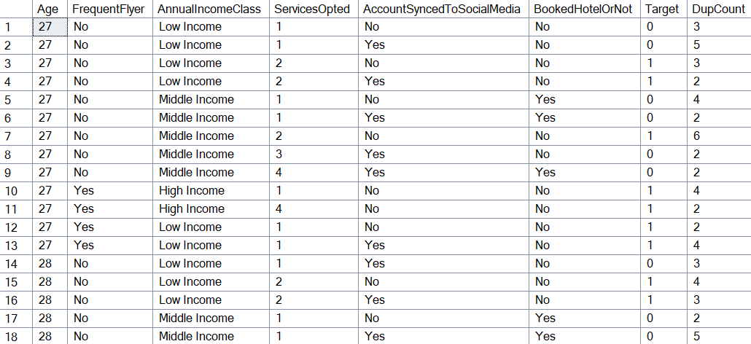
Data Discrepancy & Missing Values
There are total 205 duplicate rows
A row being a duplicate (all columns identical) does not guarantee it refers to the same real person—it might be coincidental or the result of multiple records for similar users.
The duplicated rows were kept in the data because there’s no unique identifier in that records received

Slide 13
Data Cleaning
Standardized “No Record,” blanks, NA in all applicable columns → “No”.
Made new columns for Yes/No fields to bits (1/0) for robust analytics.
Checked for and removed outlier age and service entries.
Verified all churn “Target” fields valid and within 0/1 binary.

Slide 14
Possible Analyses
Analysis Title | Purpose
Churn profiling by customer feature | Discover basic risk drivers (age, income, booking etc.)
Cohort/hotspot segmentation | Pinpoint high-risk intersections across multiple attributes
Logistic regression modeling | Quantify and weight which features drive churn risk
At-risk customer lists | Identify most urgent outreach priorities
Scenario/what-if analysis | Model campaign or offer impact on churn rates

Slide 15
KPI Dashboard
KPIs Name | Value | Description
Total Customers | 954 | All unique data rows
Total Churned | 224 | Count where Target = 1
Overall Churn Rate | 23.48% | Churned/Total
Highest Risk Cohort | 100% | HighInc +ManyServices + YesBooking + FF + NoSocialMedia
Lowest Risk Cohort | 0% | LowInc + FewServices + YesBooking + NoSocialMedia

Slide 16
EDA (Exploratory Data Analysis)
In data science and statistics, EDA stands for Exploratory Data Analysis.
It refers to techniques used to analyze and investigate data sets, summarize their main features—often with visual methods—to discover patterns, spot anomalies, and check assumptions before formal modeling.

Slide 17
1. Overall Churn Rate
Insight → The customer base exhibits a churn rate of 23.48%, indicating nearly 1 in 4 customers has stopped using the service. Retaining the remaining 76.52% is critical for future growth.
Recommendation → Focus on proactive churn reduction tactics, such as loyalty programs and personalized outreach for “at risk” segments, to convert existing customers into long-term brand advocates.

Slide 18
2. Churn Rate by Hotel Booking
Insight → Customers who did not book a hotel have a churn rate of 30.56%, much higher than those who booked (12.7%). Booking behavior appears strongly linked to retention.
Recommendation → Design incentives and cross-sell campaigns encouraging customers to book hotels. Target "non-bookers" with personalized offers or follow-ups to increase engagement and lower their churn risk.

Slide 19
3. Churn Rate by Annual Income Class
Insight → High Income customers show a strikingly high churn rate (57.86%), compared to Middle Income (6.85%) and Low Income (26.94%) groups. This reveals potential dissatisfaction among what’s likely a high-value segment.
Recommendation → Investigate reasons behind high-value customer attrition. Enhance premium offerings, tailored loyalty perks, or service quality improvements targeting high-income customers to strengthen retention in this crucial segment.

Slide 20
4. Churn by Income Class and Frequent Flyer Status
Insight → Across all income groups, Frequent Flyers consistently have higher churn rates (e.g., Low Income Frequent Flyers: 43.31%, High Income Frequent Flyers: 57.86%). The effect is particularly strong in the High Income group.
Recommendation → Revamp the Frequent Flyer program—consider new tiers, exclusive benefits, or more engaging experiences to bring higher loyalty. Test retention pilots with at-risk flyer groups across income segments.

Slide 21
5. Churn Rate by Frequent Flyer Status
Insight → Frequent Flyers churn at 51.40%, while non-members are at just 11.53%. This inversion suggests issues with either program satisfaction or that “frequent flyers” may have unmet or evolving expectations.
Recommendation → Survey and segment Frequent Flyers to identify pain points. Iterate on benefits, recognition programs, and customer service quality to rebuild trust and advocacy for this group.

Slide 22
6. Churn Rate by Account Synced to Social Media
Insight → Customers who sync their account to social media platforms experience a higher churn rate (27.50%) than those who don’t (21.04%), suggesting possible privacy/trust concerns, or weaker brand engagement.
Recommendation → Enhance perceived value and reassurance of social sync features. Provide tips, rewards, or clear privacy controls to boost engagement quality and address churn drivers in the “social sync” segment.

Slide 23
7. Distribution of Services Opted & Churn Rate by Number of Services Opted
Insight → Churn rates are lowest for customers opting for 3 services (8.06%). However, those with 5 or 6 services show a spike (37.68%, 32.81%). Customers with 2 services also churn at a higher-than-average rate (29.55%), indicating non-linear engagement effects.
Recommendation → Personalize retention strategies:
For low-engagement (1-2 services): Cross-sell more packages to deepen product usage.
For high-engagement (5-6 services): Provide premium support or loyalty rewards.
Investigate if “service overload” creates dissatisfaction in high service groups.

Slide 24
8. Churn Rate by Age Group
Insight → Customers aged 23–27 and 33–37 display the highest rates of churn (56.45% and 22.05%, respectively). The lowest churn is among those 38–42 (9.68%).
Recommendation → Conduct further analysis on pain points for the 23–27 and 33–37 brackets. Deploy age-targeted communication, offers, or product enhancements to better retain these at-risk groups.

Slide 25
10. Pareto Chart of Churn by Age Group
Insight → A small number of age groups (in particular, 28–32 and 33–37) account for over 80% of total churn, demonstrating the Pareto principle (“vital few”).
Recommendation → Prioritize churn-reduction measures for these core age brackets. Testing retention offers, onboarding, or communications in these segments will likely yield the largest impact.

Slide 26
11. Distribution of Predicted Churn Probability
Insight → The majority of customers are predicted to have a low churn probability (0–0.2), but a substantial tail of high-risk customers exist in the 0.4+ bins. Resource allocation for retention can be more data-driven.
Recommendation → Adopt predictive, targeted customer retention strategies. Prioritize outreach for customers with predicted churn probabilities above 0.4+, as they represent the highest risk.

Slide 27
12. Predictions vs. Actual Churn Outcomes (Confusion Matrix Chart)
The model correctly identifies most non-churners (True Negatives: 678) but misses 117 real churners (False Negatives) and wrongly flags 52 as churn (False Positives). Sensitivity and specificity are both areas for improvement.
Recommendation → Balance the model for better recall of churners (True Positives) by tuning threshold/cost of errors, or deploying a “human-in-the-loop” process for at-risk customer reviews before action.

Slide 28
High level metrics
Metric | Description | Value
Total Customers | Total unique customers in your data | 954
Total Churned Customers | Number of customers who have churned | 224
Churn Rate (%) | % customers churned: Churned / Total | 23.48%
Retention Rate (%) | % customers retained: 1 - Churn Rate | 76.52%
Total Services Opted | Total count of services uptake across all customers | 2325
Average Services Opted | Mean number of services opted per customer | 2.437
Max/Min Services Opted | Highest/Lowest number of services opted by a single customer | 6/1
Most Popular Age Group | Age group with largest number of customers | 30
Lowest Churn Age Group | Age group with lowest churn rate | 30
Highest Churn Age Group | Age group with highest churn rate | 27
Most Common Income Class | Income class with most customers | Middle Income
Highest Churn Income Class | Income class with highest churn rate | High Income

Slide 29
Metric | Description | Value
Lowest Churn Income Class | Income class with lowest churn rate | Middle Income
Largest Customer Segment by Services | Which ‘Services Opted’ group is largest | 1
Smallest Customer Segment by Services | Which ‘Services Opted’ group is smallest | 5
Number of Frequent Flyers (%) | % customers with Frequent Flyer status | 29.97%
% Booked Hotel | % customers who booked a hotel | 39.62%
% Synced to Social Media | % customers syncing accounts to social platforms | 37.73%
Median Churn Probability | Median of model churn score probability | 13.50%
Average Predicted Churn Probability | Average churn score (model output) | 23.48%
Model Accuracy | Overall percentage of correct predictions from confusion matrix | 82.29%
True Positive Rate (Recall) | Proportion of actual churners correctly predicted | 47.77%

Slide 30
Metric | Description | Value
True Negative Rate (Specificity) | Proportion of non-churners correctly predicted | 92.88%
False Positive Rate | % of non-churners wrongly flagged as churn | 7.12%
False Negative Rate | % of churners missed by the model | 52.23%
Churn Rate by Hotel Booking(Yes) | Churn % for “Booked Hotel = Yes” | 12.70%
Churn Rate by Hotel Booking(No) | Churn % for “Booked Hotel = No” | 30.56%
Churn Rate by Frequent Flyer(Yes) | Churn % for “Frequent Flyer = Yes” | 51.40%
Churn Rate by Frequent Flyer(No) | Churn % for “Frequent Flyer = No” | 11.53%
Churn Rate by Social Media Sync(Yes) | Churn % for “Synced = Yes” | 27.50%
Churn Rate by Social Media Sync(No) | Churn % for “Synced = No” | 21.04%

Slide 31
Power BI Dashboard Layout
Column Name

Slide 32
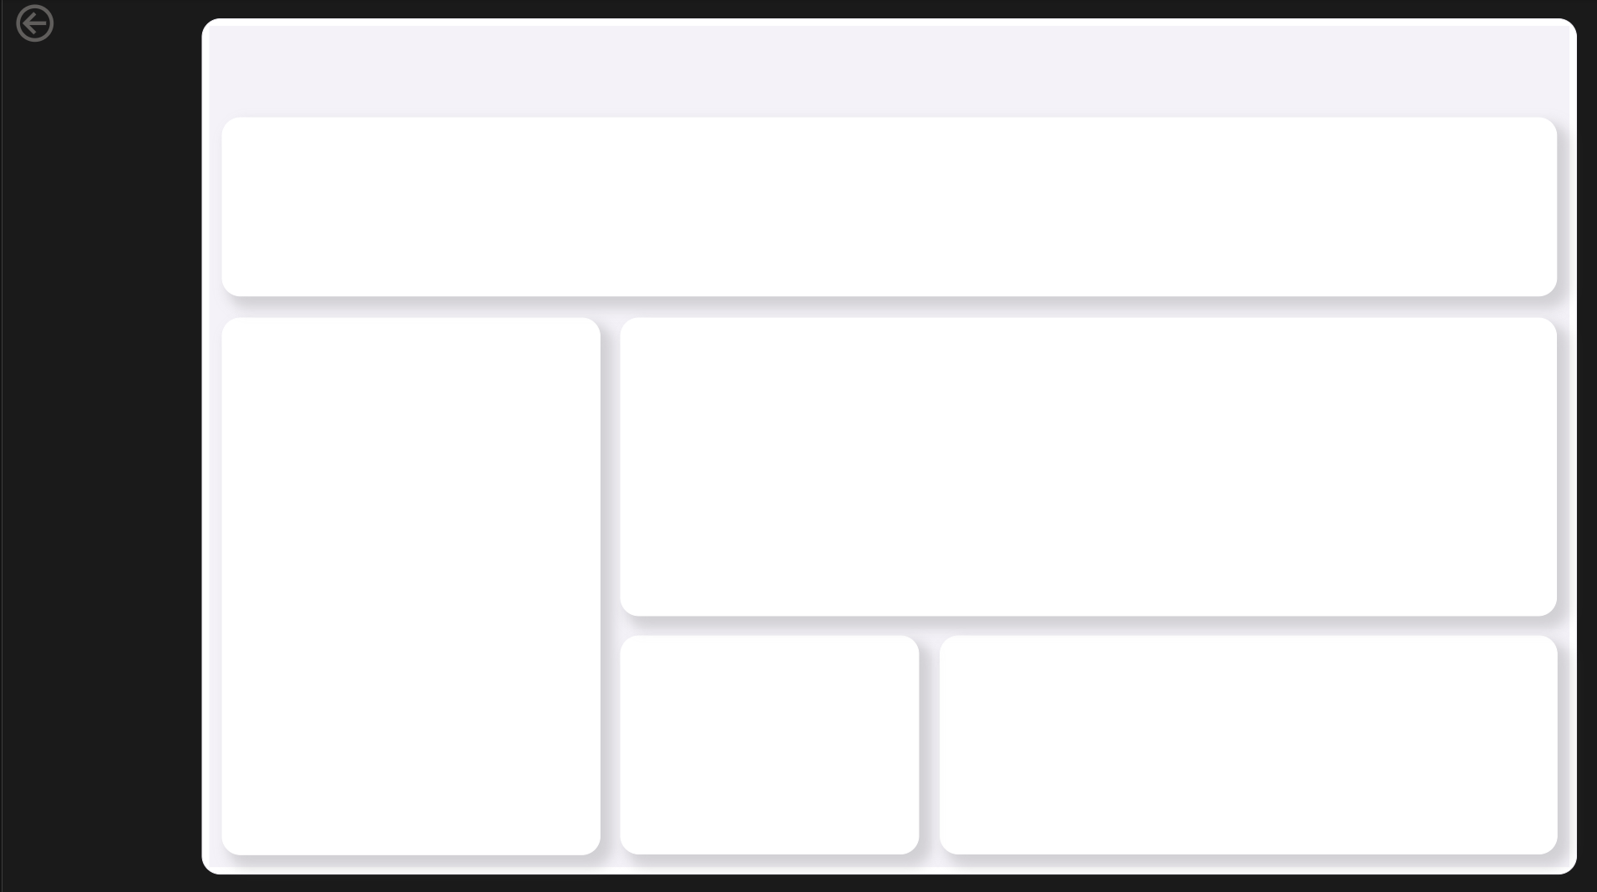
Column Name

Slide 33
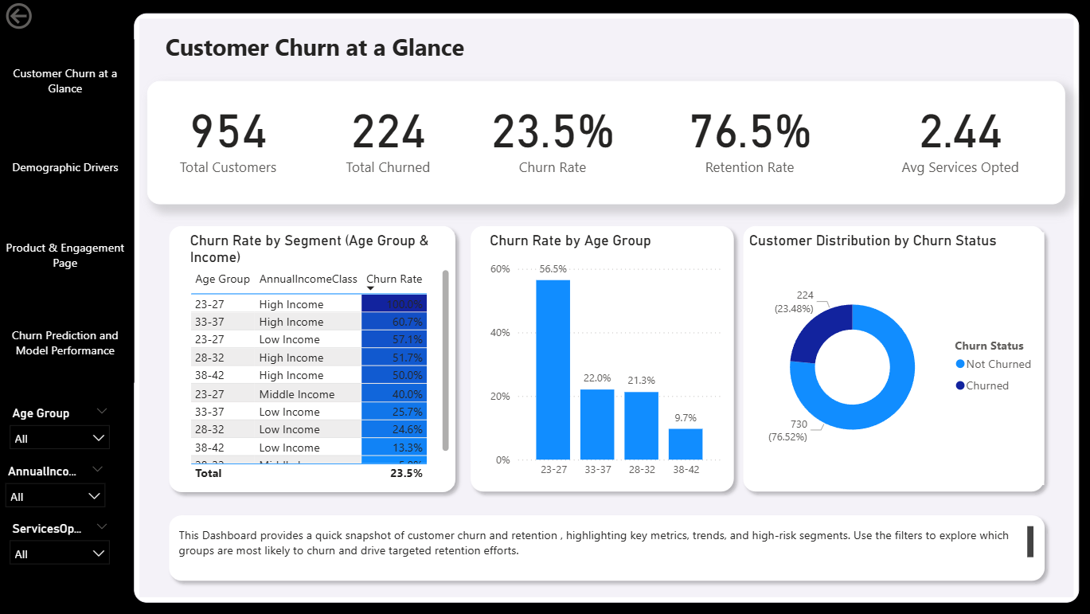


Executive Summary
Slicer
Total Customers
Total Churned Customers
Overall Churn Rate (%)
Retention Rate (%)
Age Group
Pie Chart: Share of Churned vs Not Churned
Bar Chart: Churn Rate by Top Driver
Annual Income Class
Stacked Bar Chart: Churned vs Not Churned by Services Opted
Table: Top 5 Riskiest Segments (segment + churn rate)
Services Opted

Slide 34
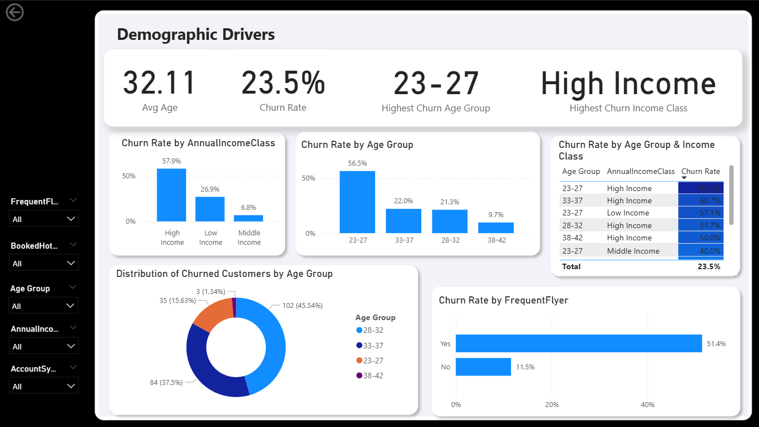
Demographic Drivers of Churn
Slicer
Average Age
Highest Churn Demographic Segment
Top 3 High-Risk Segments
Churn Rate by Income Class
Age Group
Bar/Column Chart: Churn Rate by Age Group
Bar/Column Chart: Churn Rate by Annual Income Class
Annual Income Class
Clustered Bar: Churn Rate by Frequent Flyer
Donut Chart: Customer Distribution by Demographics
Frequent Flyer

Slide 35
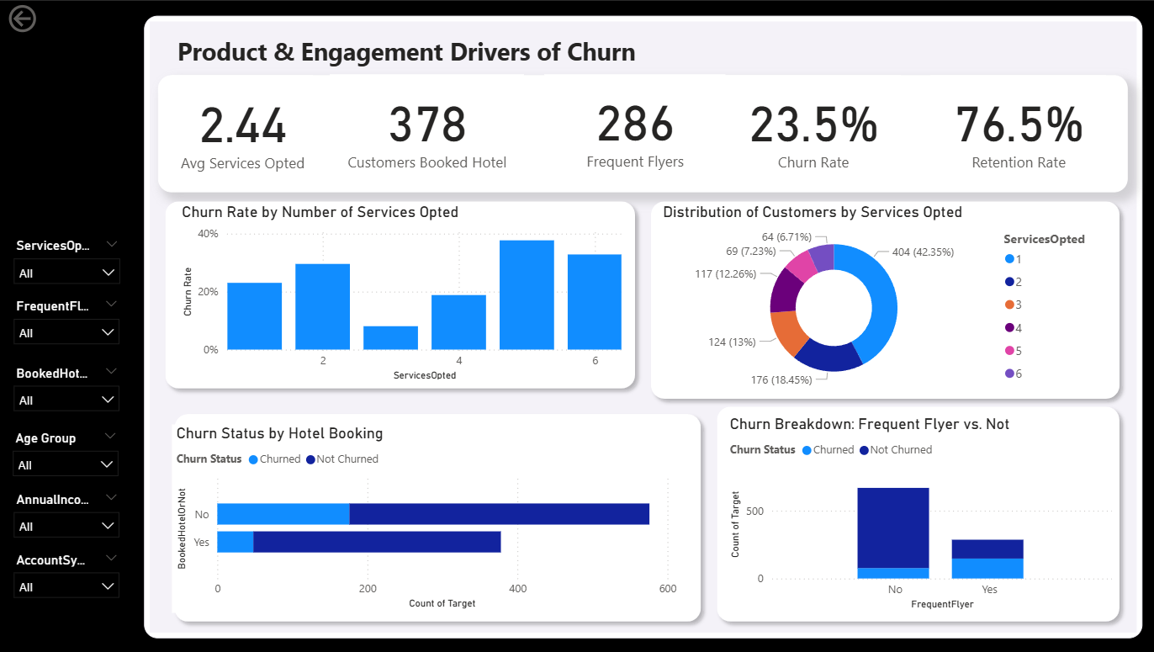
Product & Engagement Analysis
Slicer
Average Services Opted
Churn Rate for Hotel Booking Segment
Churn Rate for Synced
Churn Rate for Non-Synced Users
Services Opted
Bar Chart: Churn Rate by Services Opted
Donut Chart: Customer Distribution by Services Opted
Account Synced to Social Media
Booked Hotel Or Not
Stacked Column: Churn by Social Media Sync & Booked Hotel
Table: Top At-Risk Product Segments
Annual Income Class

Slide 36
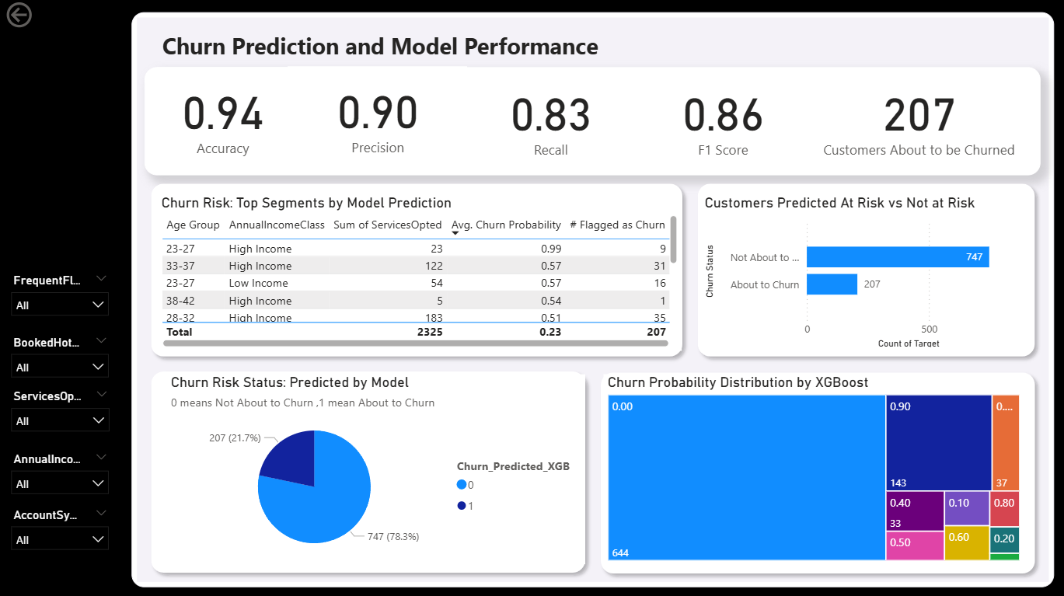
Model Performance Dashboard
Slicer
Accuracy (%)
Precision (%)
Recall (%)
F1 Score (%)
Age Group
Matrix/Heatmap: Confusion Matrix (TP, TN, FP, FN)
Bar Chart: True Churn vs Predicted Churn Counts
Target
Booked Hotel
Services Opted
Histogram: Distribution of Predicted Churn Probability
Donut Chart: % Correct vs Incorrect Predictions
Annual Income Class

Slide 37
Cohort Hotspot & Risk Analysis
Slicer
Highest Segment Churn Rate (%)
Lowest Segment Churn Rate (%)
Number of Segments Above Threshold Risk
Top 3 High-Risk Segments
Age Group
Heatmap: Churn Rate
Table: All Segments Churn Rate
Services Opted
Booked Hotel
Stacked Bar: Churned vs Not Churned Across Segments
Scatter Plot: Segment Size vs Churn Rate
Frequent Flyer

Slide 38
What-If Scenario Analysis
Slicer
Overall Churn Rate
Difference to Baseline (%)
Top Driver Under Changed Scenario
Projected Retained/Churned Customers
What-If Sliders: % Frequent Flyer, % Booked Hotel, Average Services Opted
Bar Chart: Before vs After Churn Rate
Dumbbell Chart: Shift in Customer Segments
Table: Top 5 Most Impactful Changes
Scatter/Combo: Churn vs Key Inputs
Age Group
Annual Income Class

Slide 39
THANK YOU!

